Slide 1

FUNDAMENTALS OF DATABASE SYSTEMS LESSON 8: Functional Dependencies and Normalization for Relational Databases
Department of Information Systems
University of Engineering and Technology,
Vietnam National University in Hanoi (UET-VNU)

Slide 2
Chapter Outline
Informal Design Guidelines for Relational Databases
Functional Dependencies (FDs)
Normal Forms Based on Primary Keys
General Normal Form Definitions (For Multiple Keys)
BCNF (Boyce-Codd Normal Form)

Slide 3
Chapter Outline
Informal Design Guidelines for Relational Databases
Functional Dependencies (FDs)
Normal Forms Based on Primary Keys
General Normal Form Definitions (For Multiple Keys)
BCNF (Boyce-Codd Normal Form)

Slide 4
Normal Forms Based on Primary Keys
3.1 Normalization of Relations
3.2 Practical Use of Normal Forms
3.3 Definitions of Keys and Attributes, Participating in Keys
3.4 First Normal Form
3.5 Second Normal Form
3.6 Third Normal Form

Slide 5
3.1 Normalization of Relations (1)
Normalization: The process of decomposing unsatisfactory "bad" relations by breaking up their attributes into smaller relations
There are two important properties of decompositions:
non-additive or losslessness of the corresponding join
preservation of the functional dependencies.
Normal form: Condition using keys and FDs of a relation to certify whether a relation schema is in a particular normal form
2NF, 3NF, BCNF based on keys and FDs of a relation schema

Slide 6
3.2 Practical Use of Normal Forms
Normalization is carried out in practice so that the resulting designs are of high quality and meet the desirable properties
The practical utility of these normal forms becomes questionable when the constraints on which they are based are hard to understand or to detect
The database designers need not normalize to the highest possible normal form. (usually up to 3NF, BCNF or 4NF)
Denormalization: the process of storing the join of higher normal form relations as a base relation—which is in a lower normal form

Slide 7
3.3 Definitions of Keys and Attributes Participating in Keys (1)
A superkey of a relation schema R = {A₁, A₂, ...., A_{n}} is a set of attributes S subset-of R with the property that no two tuples t₁ and t₂ in any legal relation state r of R will have t₁[S] = t₂[S]
A key K is a superkey with the additional property that removal of any attribute from K will cause K not to be a superkey any more.

Slide 8
Algorithm for computing a key of a relation
Algorithm for computing a key K of R(U) based on a functional dependency set F
Initializing K = U
For each attribute A in K
Computing {K-A}⁺_{F}
If {K-A}⁺_{F} = U then K = K-{A};

Slide 9
EX1: computing a key K of R(U) based on a functional dependency set F
F = {A →BC, B → C, BC→A, A →D }
{ABCD}⁺ = {ABCD}
{ABC}⁺ = {ABCD}
{AB}⁺ = {ABCD}
{A}⁺ = {ABCD}
Hence, A is a key of R
Note: If there is a key, then the attribute of that key belong to the left part of FDs

Slide 10
Definitions of Keys and Attributes Participating in Keys (2)
If a relation schema has more than one key, each is called a candidate key. One of the candidate keys is arbitrarily designated to be the primary key, and the others are called secondary keys.
A Prime attribute must be a member of some candidate key
A Nonprime attribute is not a prime attribute—that is, it is not a member of any candidate key.

Slide 11
3.2 First Normal Form
Disallows composite attributes, multivalued attributes, and nested relations; attributes whose values for an individual tuple are non-atomic
Considered to be part of the definition of relation

Slide 12
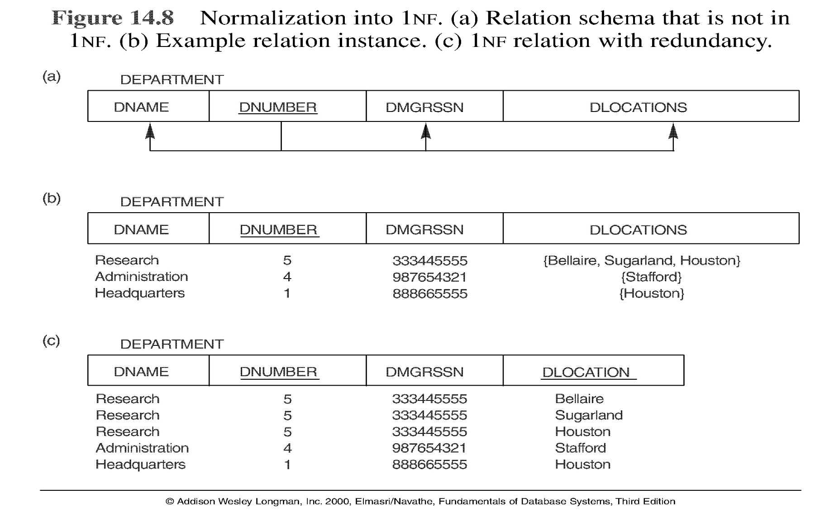
Figure Normalization into 1NF

Slide 13
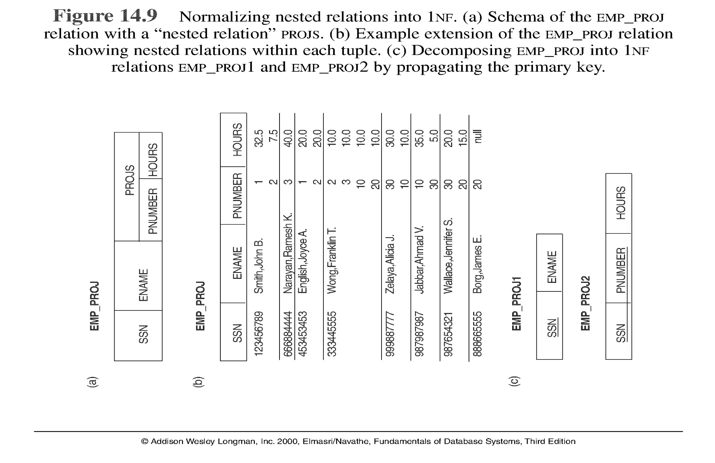

Slide 14
3.3 Second Normal Form
Uses the concepts of FDs, primary key
Definitions:
Prime attribute - attribute that is member of the primary key K
Full functional dependency - a FD Y -> Z where removal of any attribute from Y means the FD does not hold any more
Examples:
{SSN, PNUMBER} -> HOURS is a full FD since neither SSN -> HOURS nor PNUMBER -> HOURS hold
{SSN, PNUMBER} -> ENAME is not a full FD (it is called a partial dependency ) since SSN -> ENAME also holds

Slide 15
Second Normal Form
A relation schema R is in second normal form (2NF)
If R is in 1NF, and
Every non-prime attribute A in R is fully functionally dependent on the primary key
R can be decomposed into 2NF relations via the process of 2NF normalization

Slide 16
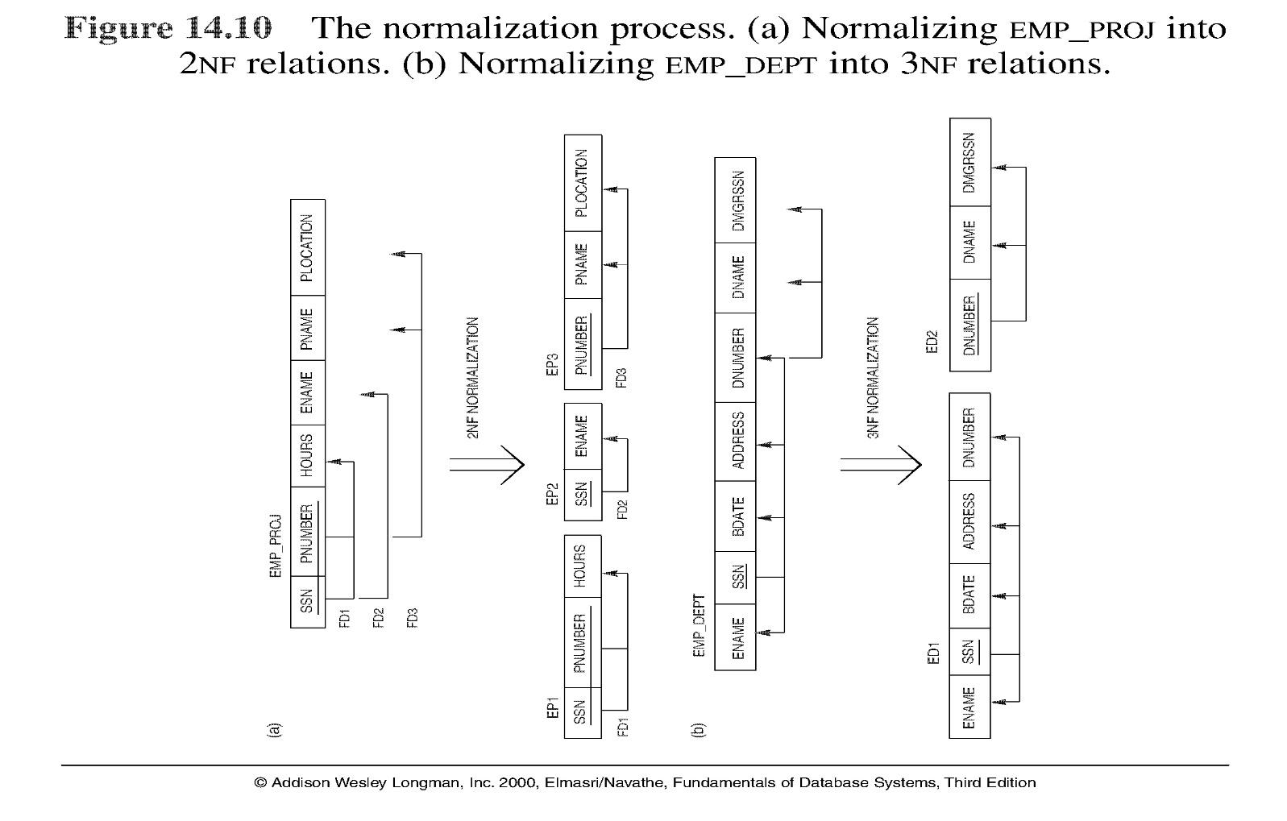

Slide 17
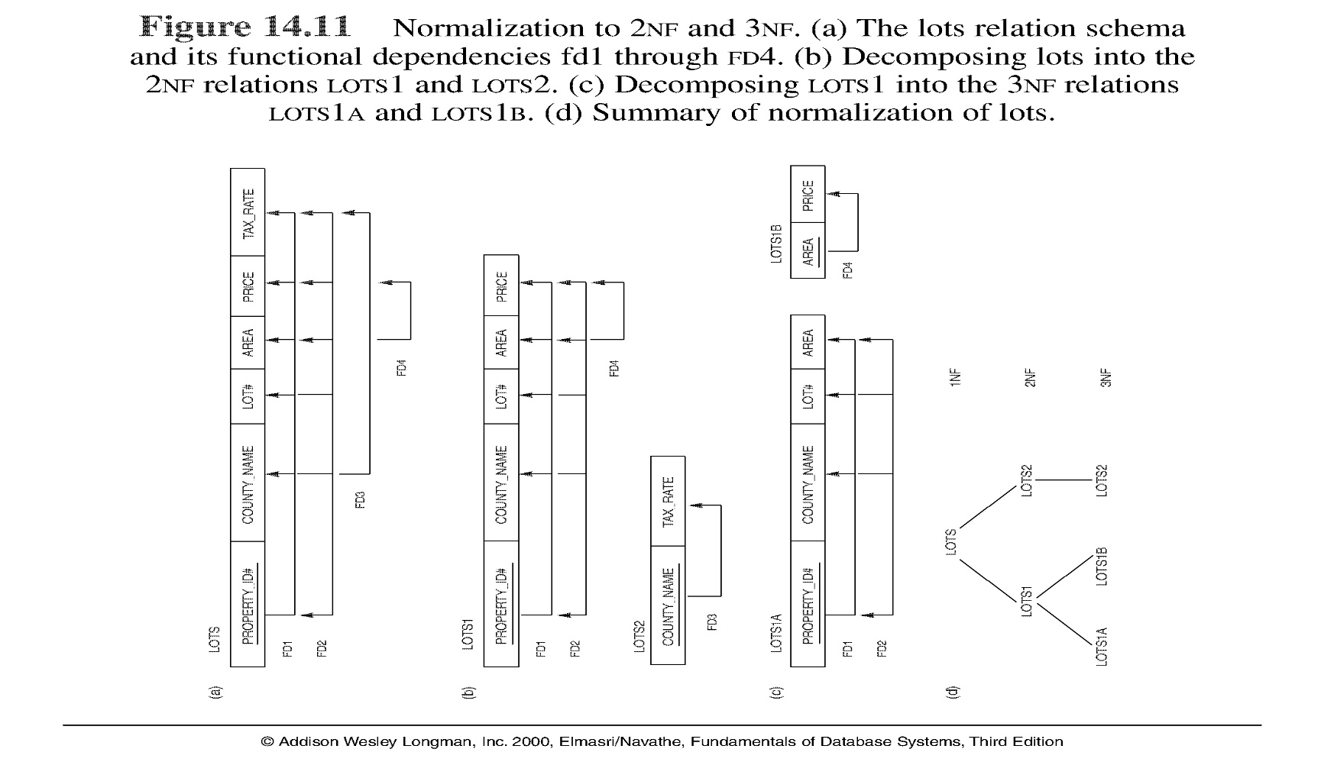
Note: The above figure is now called Figure 10.11 in Edition 4

Slide 18
Ví dụ 1: Chuẩn hóa quan hệ R thành dạng chuẩn 2
R(A,B,C,D,E)
F ={ AB→C, AB→ D, AB→ E, B → C, A → E}
B → C
A → E
Khóa chính ?:
AB
Các phụ thuộc hàm bộ phận?:
R1 (A,E) F1 = { A→ E}
R2(B,C) F2 = { B→ C}
R(A,B,D) F = { AB→ D}

Slide 19
Phụ thuộc hàm và chuẩn hóa CSDL quan hệ
Nhập môn Cơ sở Dữ liệu
b. Dạng chuẩn 2
Ví dụ 2: Chuẩn hóa quan hệ R thành dạng chuẩn 2
R(A,B,C,D,E,F,G,H)
F ={ AB→C, AB→ D, AB→ E, AB→F, AB→G, AB→H
B → C, A → E, B → G}
B → C
A → E
B → G
Khóa chính ?:
Các phụ thuộc hàm bộ phận?:
R1 (A,E) F1= {A → E }
R2(B,C, G) F2= {B → C, B → G }
R(A,B,D,F,H) F ={ AB→ D, AB→F, AB→H }

Slide 20
3.4 Third Normal Form
Definition:
Transitive functional dependency - a FD X -> Z that can be derived from two FDs X -> Y and Y -> Z
Examples:
SSN -> DMGRSSN is a transitive FD since
SSN -> DNUMBER and DNUMBER -> DMGRSSN hold
SSN -> ENAME is non-transitive since there is no set of attributes X where SSN -> X and X -> ENAME

Slide 21
Third Normal Form
A relation schema R is in third normal form (3NF)
if it is in 2NF and
No non-prime attribute A in R is transitively dependent on the primary key
R can be decomposed into 3NF relations via the process of 3NF normalization
NOTE:
In X -> Y and Y -> Z, with X as the primary key, we consider this a problem only if Y is not a candidate key. When Y is a candidate key, there is no problem with the transitive dependency .
E.g., Consider EMP (SSN, Emp#, Salary ).
Here, SSN -> Emp# -> Salary and Emp# is a candidate key.

Slide 22
Chuẩn hóa(1-3)
Bài tập1 : Cho lược đồ: R(ABCDEFGHIJK)
Với F ={ AB→C, A → DE, B → F, F →GH, D → IJK }
Xác định khóa của R, chuyển về dạng chuẩn 2, 3
Khóa:
AB
Chuẩn 2:?
D, E, F phụ thuộc bộ phận vào khóa chính
R1(ADEIJK) với F1 ={ A → D, A → E, D → IJK }
R2(BFGH) với F2 ={ B→F, F →GH }
R(ABC) với F ={ AB→C}
Chuẩn 3:?
Có phụ thuộc bắc cầu?

Slide 23
Chuẩn hóa(1-3)
Bài tập 1 (cont):
Khóa:
AB
Chuẩn 2:
R1(ADEIJK) với F1 ={ A → D, A → E, D → IJK }
R2(BFGH) với F2 ={ B→F, F →GH }
R(ABC) với F ={ AB→C}
Chuẩn 3:?
Có phụ thuộc bắc cầu?
R11(DIJK) với F11 ={ D → IJK }
R12(ADE) với F12 ={ A → D, A → E }
R21(FGH) với F21 ={ F →GH }
R22(BF) với F2 2={ B →F }
R(ABC) với F ={ AB→C}

Slide 24
Chuẩn hóa(1-3)
Bài tập 2 : Cho lược đồ: R(ABCDEFGHIJK)
Với F ={ AB→C, BD → EF, AD → GH, A →I, H → JK }
Xác định khóa của R, chuyển về dạng chuẩn 2, 3
Khóa:
Chuẩn 2:?
Chuẩn 3:?

Slide 25
Chapter Outline
Informal Design Guidelines for Relational Databases
Functional Dependencies (FDs)
Normal Forms Based on Primary Keys
General Normal Form Definitions (For Multiple Keys)
BCNF (Boyce-Codd Normal Form)

Slide 26
4 General Normal Form Definitions (For Multiple Keys)
The above definitions consider the primary key only
The following more general definitions take into account relations with multiple candidate keys
A relation schema R is in second normal form (2NF) if every non-prime attribute A in R is fully functionally dependent on every key of R

Slide 27
General Normal Form Definitions (2)
Definition:
Superkey of relation schema R - a set of attributes S of R that contains a key of R
A relation schema R is in third normal form (3NF) if whenever a FD X -> A holds in R, then either:
(a) X is a superkey of R, or
(b) A is a prime attribute of R
NOTE: Boyce-Codd normal form disallows condition (b) above

Slide 28
Chapter Outline
Informal Design Guidelines for Relational Databases
Functional Dependencies (FDs)
Normal Forms Based on Primary Keys
General Normal Form Definitions (For Multiple Keys)
BCNF (Boyce-Codd Normal Form)

Slide 29
5 BCNF (Boyce-Codd Normal Form)
A relation schema R is in Boyce-Codd Normal Form (BCNF)
if it is in 3NF and
whenever an FD X -> A holds in R, then X is a superkey of R
Each normal form is strictly stronger than the previous one
Every 2NF relation is in 1NF
Every 3NF relation is in 2NF
Every BCNF relation is in 3NF
There exist relations that are in 3NF but not in BCNF
The goal is to have each relation in BCNF (or 3NF)

Slide 30
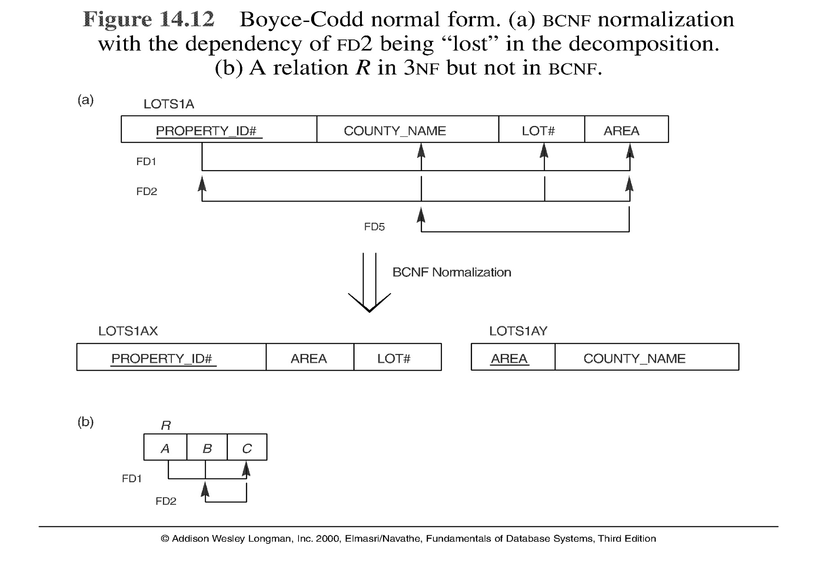
Figure Boyce-Codd normal form

Slide 31
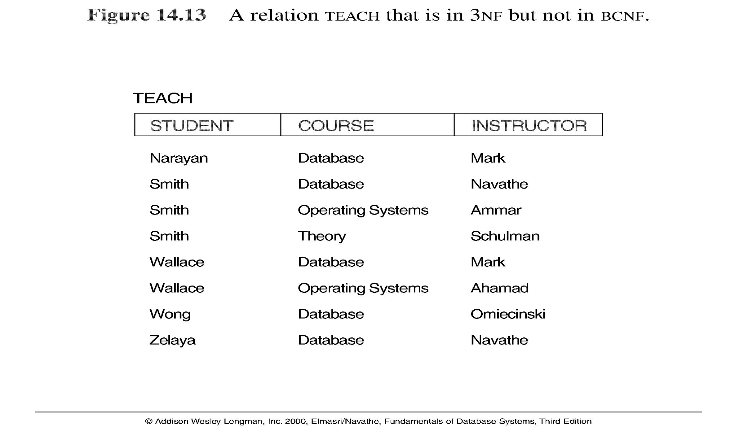
Figure a relation TEACH that is in 3NF but not in BCNF

Slide 32
Achieving the BCNF by Decomposition
Two FDs exist in the relation TEACH:
fd1: { student, course} -> instructor
fd2: instructor -> course
{student, course} is a candidate key for this relation. So this relation is in 3NF but not in BCNF
A relation NOT in BCNF should be decomposed so as to meet this property, while possibly forgoing the preservation of all functional dependencies in the decomposed relations.

Slide 33
Achieving the BCNF by Decomposition
Three possible decompositions for relation TEACH
{student, instructor} and {student, course}
{course, instructor } and {course, student}
{instructor, course } and {instructor, student}
All three decompositions will lose fd1. We have to settle for sacrificing the functional dependency preservation. But we cannot sacrifice the non-additivity property after decomposition.
Out of the above three, only the 3rd decomposition will not generate spurious tuples after join (and hence has the non-additivity property).

Slide 34
Chuẩn hóa lược đồ về dạng BCNF
Ví dụ 1:
Cho R (A,B,C,D,E)
Với các phụ thuộc hàm:
F={AB → C, AB → D, AB → E, D → B}
không thỏa mãn BCNF
R1 (B,D)
F1={D → B}
R2 (A,D,C,E)
F2={AD → C, AD → E}

Slide 35
Chuẩn hóa lược đồ về dạng BCNF
Ví dụ 2:
Cho R (ABCDEGH)
F={ABC→ D, ABC → E, ABC → G, ABC → H ,DE → AB}
R1 (ABDE)
F1={DE → A, DE → B}
R2 (CDEGH)
F2={CDE → G, CDE → H}

Slide 36
Các bước Chuẩn hóa lược đồ về dạng BCNF
b1: Tách các thuộc tính không khóa và thuộc tính khóa phụ thuộc hàm vào thuộc tính không khóa đó thành quan hệ mới, thuộc tính không khóa đó trở thành khóa trong quan hệ mới.
b2: Loại các thuộc tính khóa ở bước 1 khỏi lược đồ gốc
b3: Bổ sung thuộc tính không khóa xác định hàm thuộc tính khóa đã loại bỏ (bước 2) vào khóa của quan hệ gốc

Slide 37
Chuẩn hóa lược đồ về dạng BCNF
Ví dụ 3:
Cho R (ABCDEGH)
F={ABC→ D, ABC → E, ABC → G, ABC → H,
D → A, E →C}
R1 (AD)
F1={D → A}
R2 (EC)
F2={E → C}
R(BDEGH)
F={BDE → G, BDE → H}

Slide 38
Bài tập về các dạng chuẩn
Bài tập ví dụ:
Cho quan hệ R(ABCDEFG) ; khóa AB
F={AB → C, AB → D, AB → E, AB → F, AB → G, A→ E,
A→F, A→G, F→G}
? R đạt chuẩn nào.
? Hãy chuẩn hóa từng bước để đạt chuẩn cao hơn.

Slide 39
Bài tập về các dạng chuẩn
1. cho R(ABCDEFG); F={AB → C, AB → D, AB → E, AB → F,
AB → G, A→ E, A→F, A→G, F→G, D →B}
1NF ?
2NF ?
có phụ thuộc bộ phận vào khóa ?
R1(AEFG); F1={ A→ E, A→F, A→G, F→G}
R2(ABCD); F2={AB → C, AB → D, D →B}
3NF ?
R1
có thuộc tính không khoá phụ thuộc bắc cầu?
R11(FG); F11={ F→G}
R12(AEF); F12={A→ E, A→F}
BCNF
BCNF ?
có thuộc tính khóa phụ thuộc vào thuộc tính không khóa ?
R21(BD); F21={D →B}
R22(ACD); F22={AD → C}

Slide 40
Bài tập về các dạng chuẩn
2. Cho R(ABCDEFGHIJ)
F ={ AB→C, BD→EF, AD → GH, A →I, H →J}
Xác định khóa của R; Chuẩn hóa R về dạng chuẩn cao hơn
Khóa của R: ABD
2NF
có phụ thuộc bộ phận?
R1(AI) ,F1 ={ A →I}
R₂(ABC),F₂ ={ AB→C}
R₃(BDEF),F₃ ={ BD→EF}
R₄(ADGHJ),F₄ ={ AD → GH, H →J}
3NF
có phụ thuộc bắc cầu?
R₄₁(HJ),F₄₁={ H →J}
R₄₂(ADGH),F₄₂ ={ AD → GH}

Slide 41


